Slide 1
VLSI Design Issues
Notes:
Good Morning!
The title of today’s talk is “On some Planar Partitioning Problems”.

Slide 2
Complexity Acronyms
SSI = small scale integration (~100 components)
MSI = medium scale integration (~1000 components)
LSI = large scale integration (~10⁵ components)
VLSI = very large scale integration (~10⁵ - 10⁶ components)
ULSI = ultra large scale integration (~10⁶ - 10⁹ components)
GSI = giga-scale integration (> 10⁹ components)

Slide 3

Design Issues and Metrics
Cost
Reliability
Speed
Power
Energy dissipation
Time-to-market

Slide 4
VLSI Chip Yield
A manufacturing defect is a finite chip area with electrically malfunctioning circuitry caused by errors in the fabrication process.
A chip with no manufacturing defect is called a good chip.
Fraction (or percentage) of good chips produced in a manufacturing process is called the yield. Yield is denoted by symbol Y.
Notes:
2

Slide 5
Importance of Yield
Cost of a chip =
Cost of fabricating and testing a wafer
⎯⎯⎯⎯⎯⎯⎯⎯⎯⎯⎯⎯⎯⎯⎯⎯⎯⎯⎯
Yield × Number of chip sites on the wafer

Slide 6
Clustered VLSI Defects
Good chips
Faulty chips
Defects
Wafer
Unclustered defects
Wafer yield = 12/22 = 0.55
Clustered defects (VLSI)
Wafer yield = 17/22 = 0.77
Notes:
3

Slide 7
Defining Terms
Design synthesis: Given an I/O function, develop a procedure to manufacture a device using known materials and processes.
Verification: Predictive analysis to ensure that the synthesized design, when manufactured, will perform the given I/O function.
Test:
  Characterization: A test that debugs test program by fault diagnosis.
  Manufacturing test: A step that ensures that the physical device, manufactured from the synthesized design, has no manufacturing defect.

Slide 8
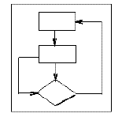
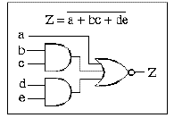
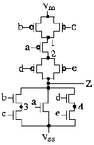
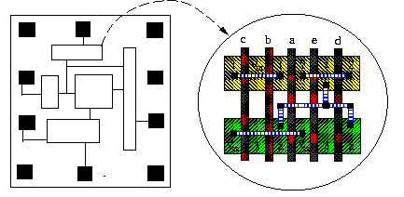
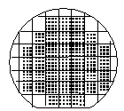

VLSI Design Flow
System Specification
functional simulation
specification
Function/architecture Design
logic simulation
behavioral representation
Logic Synthesis
circuit analysis
structural representation
Circuit Design
extraction & verification
structural representation
Physical Synthesis
physical representation
Fabrication
Packaging

Slide 9
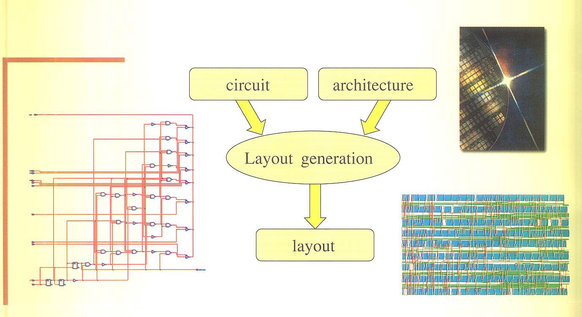
Physical Design

